Slide 1



SMART INDIA HACKATHON 2025
KACHRA SETU
Problem Statement ID – 25060
Problem Statement Title- Real life solutions for Waste Management.
Theme- Clean & Green Technology
PS Category- Software
Team ID-
Team Name- Quantum coders

Slide 2

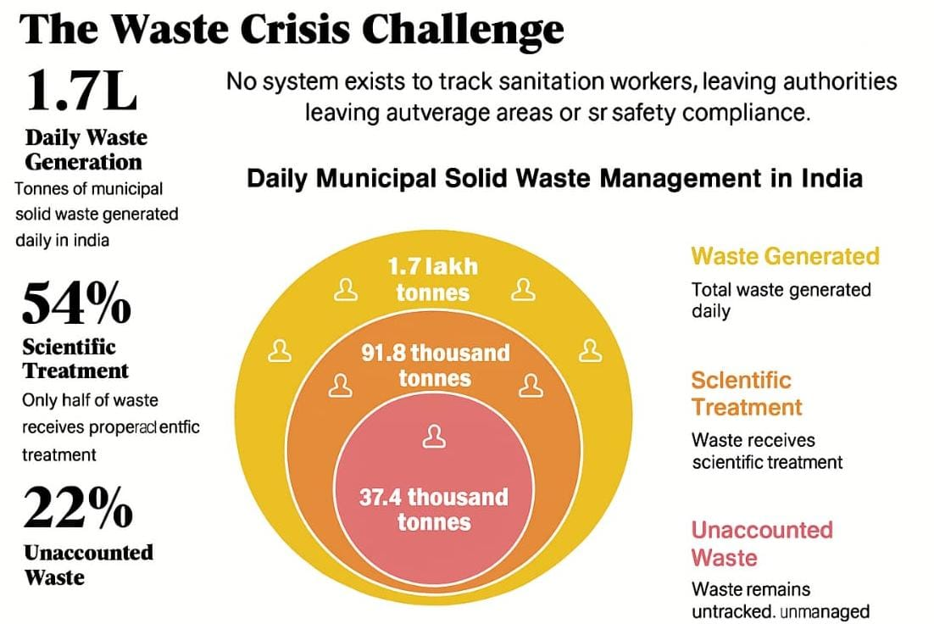
WASTE MANAGEMENT - Kachra Setu
Problem Statements and their solutions :-
1. 🗑 Lack of Source Segregation
Train workers & citizens
Awareness via videos & programs
2. 👷Unsafe Conditions for Workers
Mandatory registration & gear check (AI verified)
Insurance & healthcare support
3. 📡Technology & Monitoring
GPS tracking & digital mapping
AI chatbot & online scrap selling
4. 🆔 Weak Ground-level Monitoring
Worker login/logout with ID
Daily segregation & disposal monitoring
5. ⚠ Weak Penalty Enforcement
Strict fines for non-segregation
6. 🎁 Low Motivation among Bulk Generators
Tax rebates for compliant groups
Credit points redeemable for rewards
7. 🤝 Registration & Partnerships
Public-private partnerships
Biogas plant setups for wet waste

Slide 3
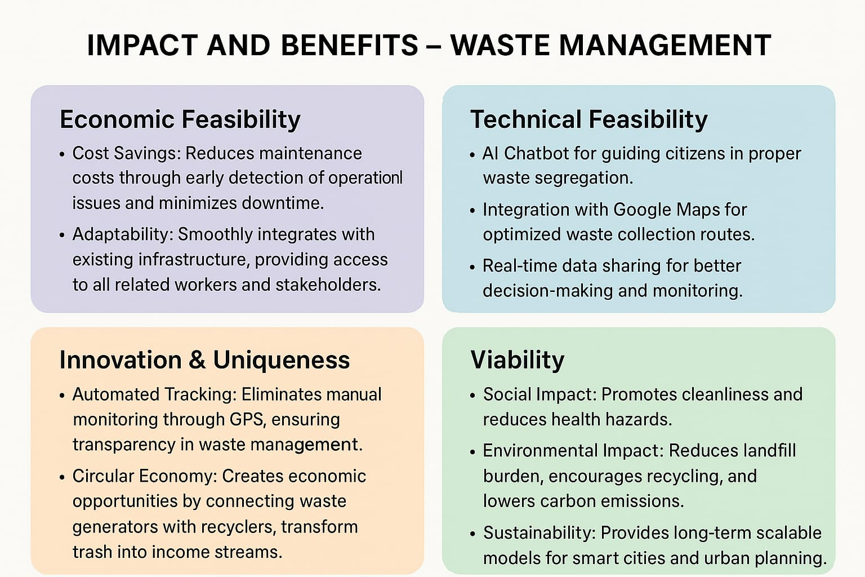

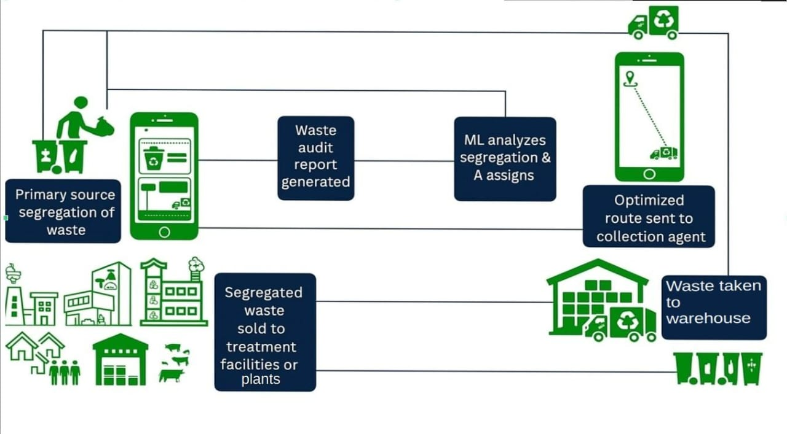
OUR MODEL

Slide 4


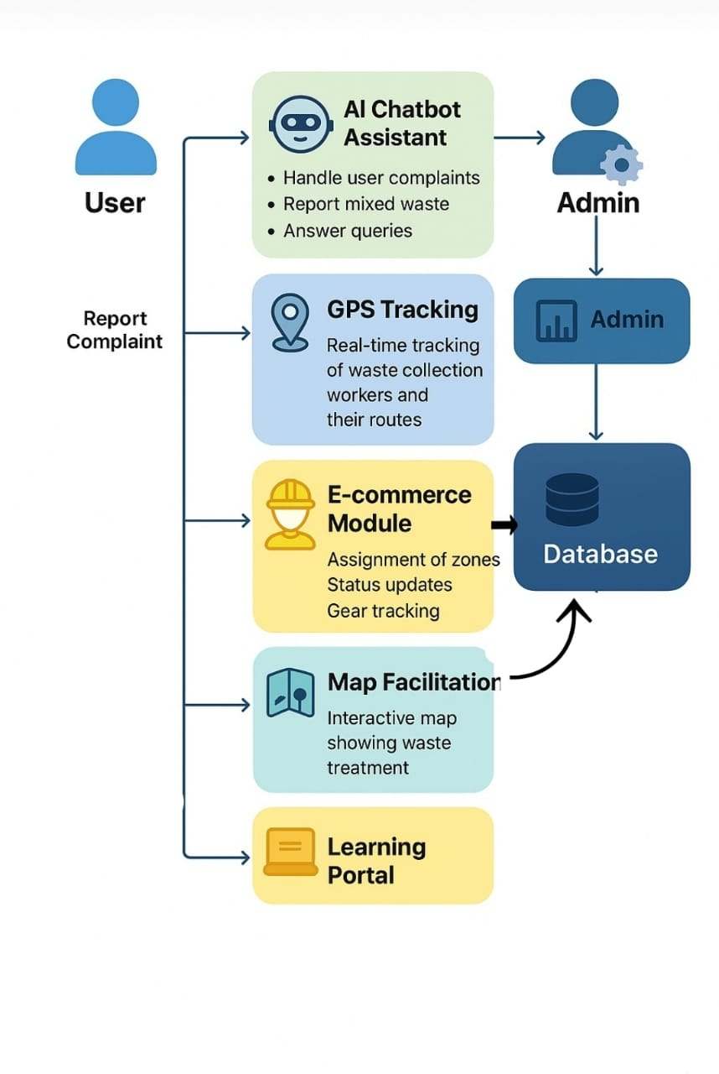
Technical approach
Frontend
• ReactJS
Backend
• FastAPI
Database
• ChromaDB
APIs
• Chroma API – for Database
• Gemini API – for chatbot
• Open route service – for maps
Deploymtent
• Ola Krutrium Cloud

Slide 5


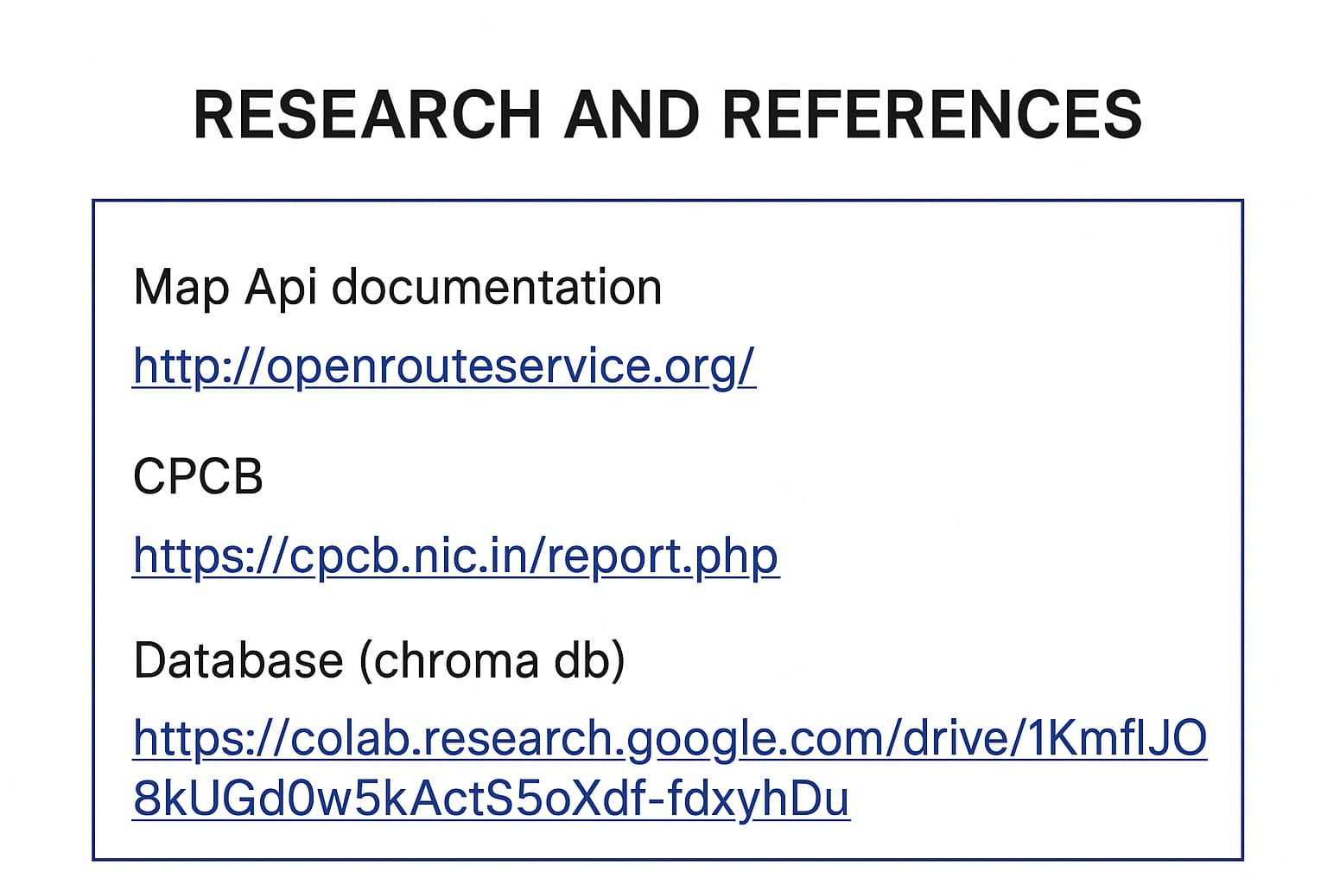
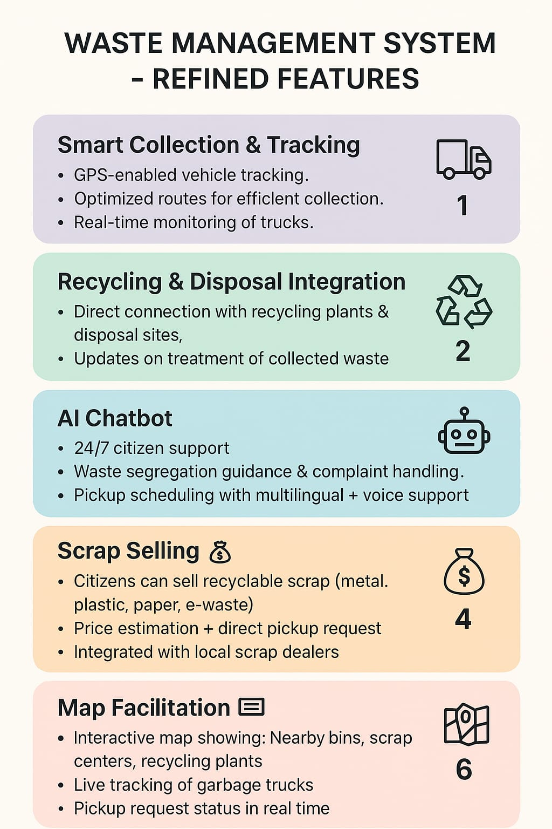

Slide 6
